Slide 1
From PowerCLI to API
Taking Your Automation Skills to the Next Level
Joe Houghes

Slide 2

Many thanks to our sponsors:

Slide 3

Joe Houghes
Senior Solutions Architect, Pure Storage
PowerShell & VMware User Group Leader
Veeam Vanguard
VMware vExpert (Pro)
Cisco Champion
Tanzu Vanguard

Slide 4




Start with a Plan
Define a Goal
Speed & Performance
Focus instead…
MVP

Slide 5
PowerShell, PowerCLI, API Don’t forget the PowerShell basics
Get-Help is your friend; make your life easier
PowerShell — Built for pipeline; embrace & use it
Stack cmdlets & results like Lego (Buy a set if you are outdated on the concept)
Forget what your teachers told you… Cheat/look up the answer whenever possible

Slide 6
Which API?
SOAP
REST
Older API (protocol/standard)
Used by PowerCLI & pyVmomi
XML-based, more rigid, not as simple as described
Many more examples for usage
Architecture used for newer APIs
Some new features only in REST
Translates to APIs other than vSphere

Slide 7
Which LEVEL?
High
Low
Get-Cluster, Get-Host, Get-VM
Most Use Cases
Easy to Read
Pipeline
Abstracts the APIs
(Overhead)
Get-View
100% API Access (Properties at least)
Not Always Easy to Read
Need to Understand the API
Have to RTFM
(Ugh, it’s not Get-Help)

Slide 8
Demos
We love Demos!

Slide 9

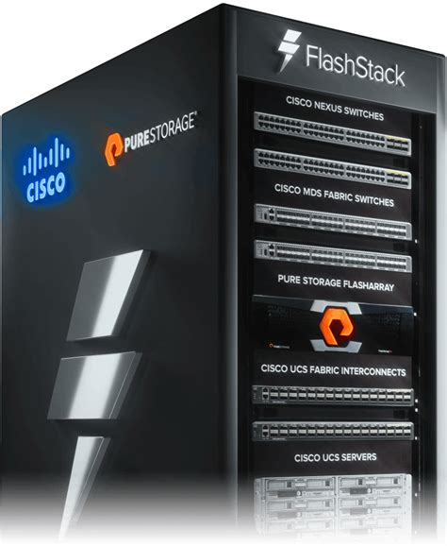
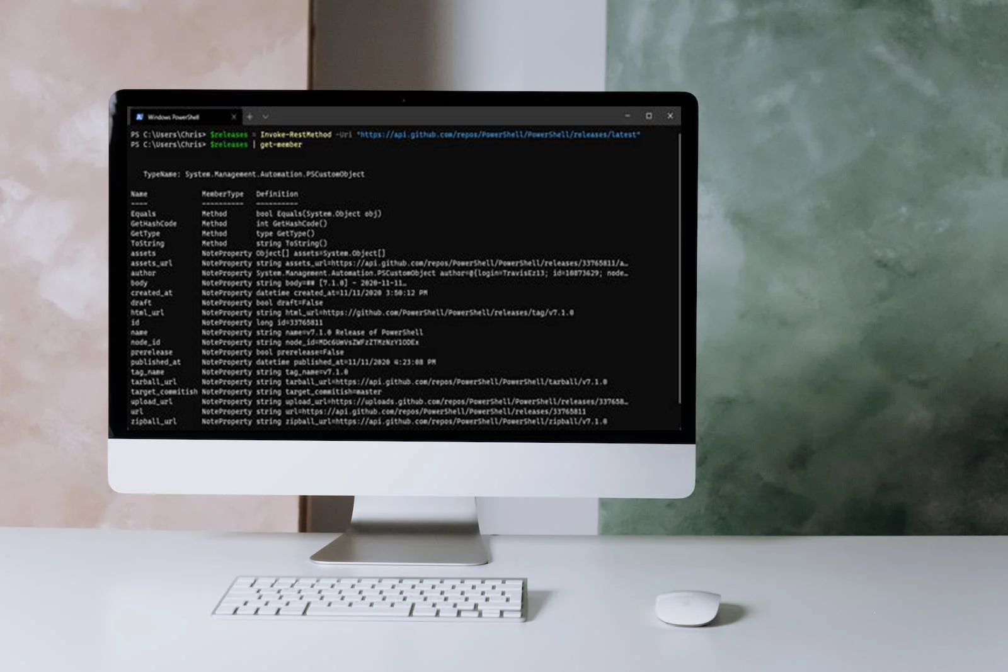
JSON
CLIENT
SERVER
GET
POST
PATCH
DELETE
(HTTP METHODS)

Slide 10
(HTTP METHODS)
C
CREATE
POST
R
READ
GET
U
UPDATE
PATCH
D
DELETE
DELETE

Slide 11
Demos
We love Demos!

Slide 12
Q&A
15 minutes

Slide 13
Resources
PowerCLI:
https://developer.vmware.com/
Used in Demos:
‘Show-Object’ (PowerShellCookbook module - PSGallery)

